Slide 1
PORTABLE SURROUND CAM CONTROL (HOTEL MANAGEMENT)

Slide 2
CONTENTS
Objective
Components
Software Description
Hardware Description
Project Description
Advantages and Disadvantages
Applications
Expected Outcome
Future Scope
Conclusion

Slide 3
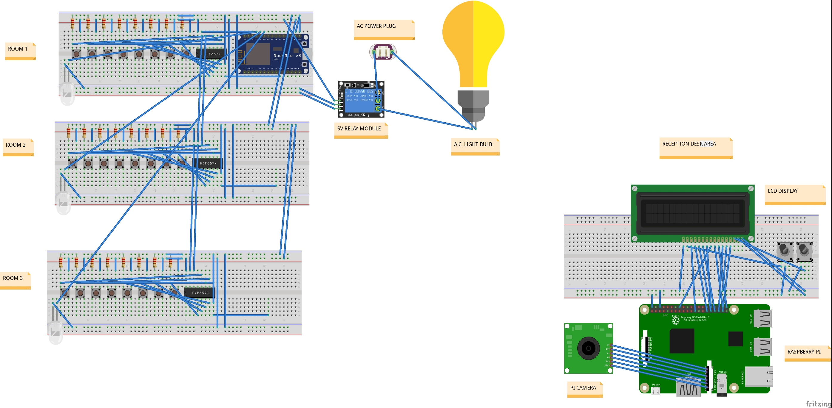
RECEPTION DESK
ROOMS AND CORRIDOR AREA
FINAL OVERVIEW

Slide 4
OBJECTIVE
By implementing this system we can bring a good change in restaurants and hotel industry.
This system will save a lot of time, human efforts, electricity and increases security.
Not only for customers but also for staffs it would be easy to manage the whole hotel.

Slide 5
COMPONENTS
Raspberry pi 3 B
NodeMCU
Pi Camera
16x2 LCD display
LEDs
Pushbuttons
Power supply circuit
SD card
PCBs and Wires
PCF8574 Module
Relays

Slide 6
SOFTWARE DESCRIPTION
Raspbian:
It is the official operating system(O.S.) of Raspberry Pi. Since Python is the programming language of Raspberry Pi, Raspbian comes with pre-installed Python.
Arduino:
It is integrated development environment(IDE) used for running nodeMCU, Relay, PCF8574.
Python:
Most of the coding/programming section is made using Python language.
Android Studio:
For creating and building mobile applications based on Android O.S.

Slide 7
Proteus:
Proteus is an electronic circuit design software which includes a schematic capture, simulation and PCB ( Printed Circuit Board) Layout modules.
Multisim:
Multisim is industry standard SPICE simulation and circuit design software for analog, digital, and power electronics. It integrates industry standard SPICE simulation with an interactive schematic environment to instantly visualize and analyze electronic circuit behavior.
Fritzing:
Fritzing is an open-source initiative to develop amateur or hobby CAD software for the design of electronics hardware, to support designers and artists ready to move from experimenting with a prototype to building a more permanent circuit.

Slide 8
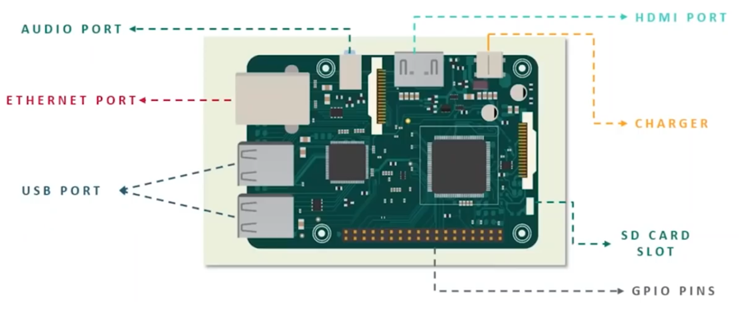
HARDWARE DESCRIPTION
Raspberry Pi:
It is a single board computer(S.B.C.) powered by Broadcom BCM2837 64-bit ARMv7 Quad core processor, running at 1.2GHz. With 1GB RAM and built-in WiFi and Bluetooth.

Slide 9
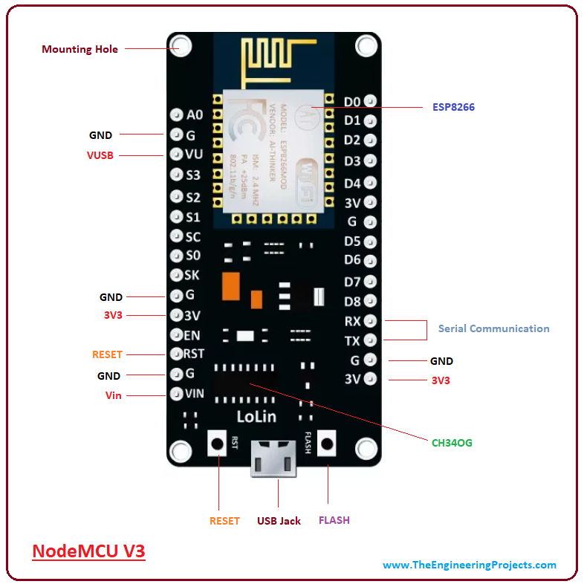
NodeMCU:
NodeMCU is an open source IoT platform. Which includes firmware which runs on the ESP8266 Wi-Fi Module from Espressif Systems,and hardware which is based on the ESP-12 module.

Slide 10
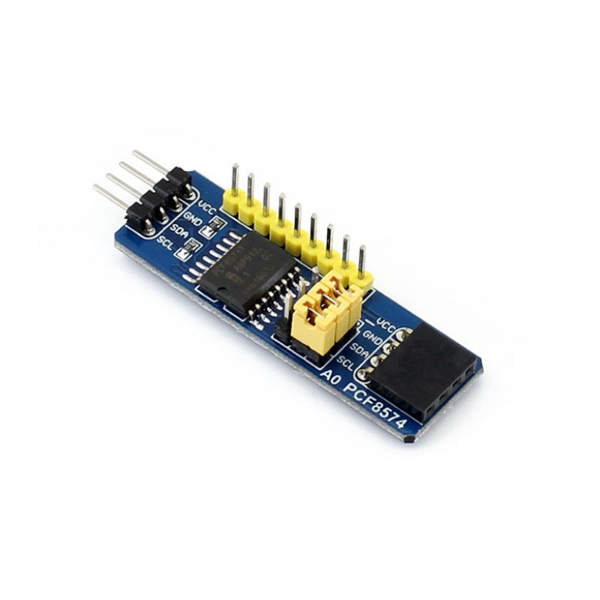
PCF8574 I2C module:
The PCF8574/74A provides general-purpose remote I/O expansion via the two-wire bidirectional I2C-bus (serial clock (SCL), serial data (SDA)). The devices consist of eight quasi-bidirectional ports, 100 kHz I2C-bus interface, three hardware address inputs and interrupt output operating between 2.5 V and 6 V.

Slide 11
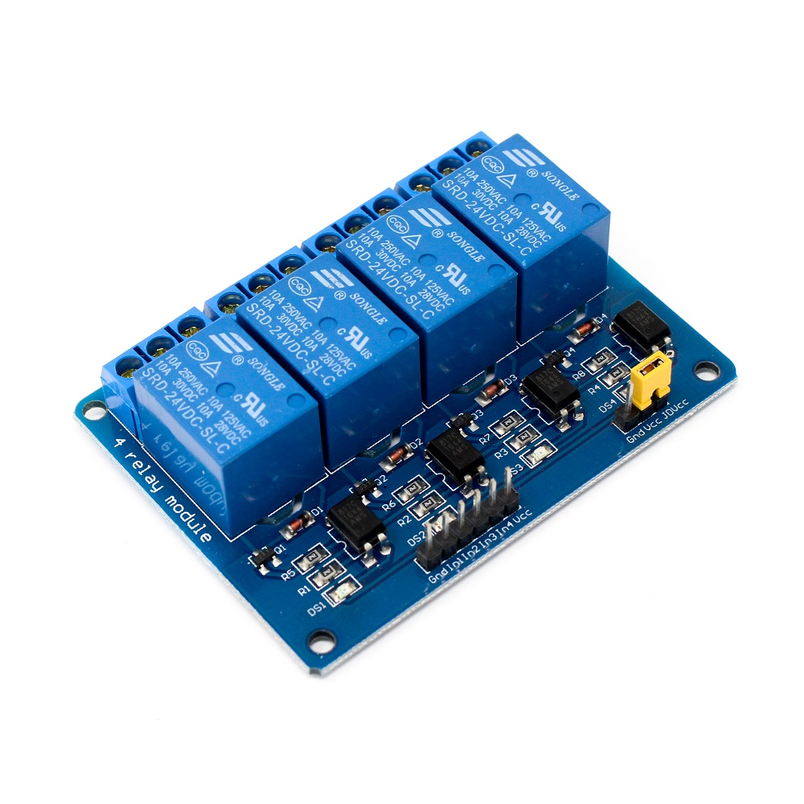
4-Relay module:
The 4 Channel Relay Module is a convenient board which can be used to control high voltage, high current load such as motor, solenoid valves, lamps and AC load. It is designed to interface with microcontroller such as Arduino, PIC and etc. The relays terminal (COM, NO and NC) is being brought out with screw terminal. It also comes with a LED to indicate the status of relay.

Slide 12
PROJECT DESCRIPTION
Portable Surround Cam Control(PSCC) is a hotel based management system, which aims at:
1) Wireless communication 2) Cost effective system 3) User friendly user interface
This project has been divided into 4 sections:-
Room Booking at reception
Food ordering via mobile application
Room service via mobile application/buttons module
Hotel Automation

Slide 13
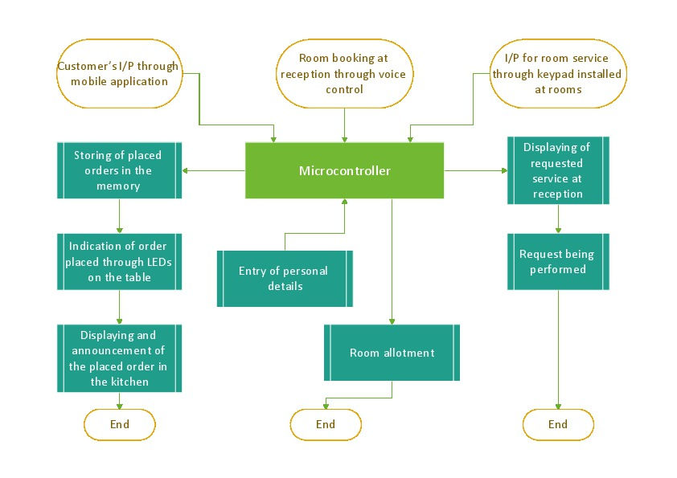
PROCESSES RUNNING IN PARALLEL

Slide 14
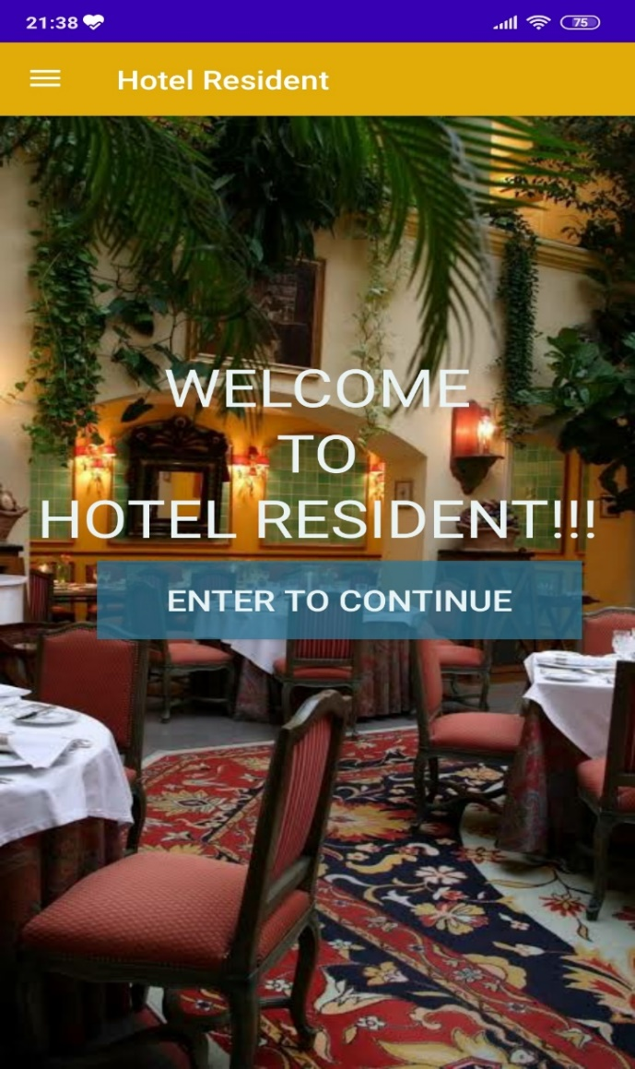
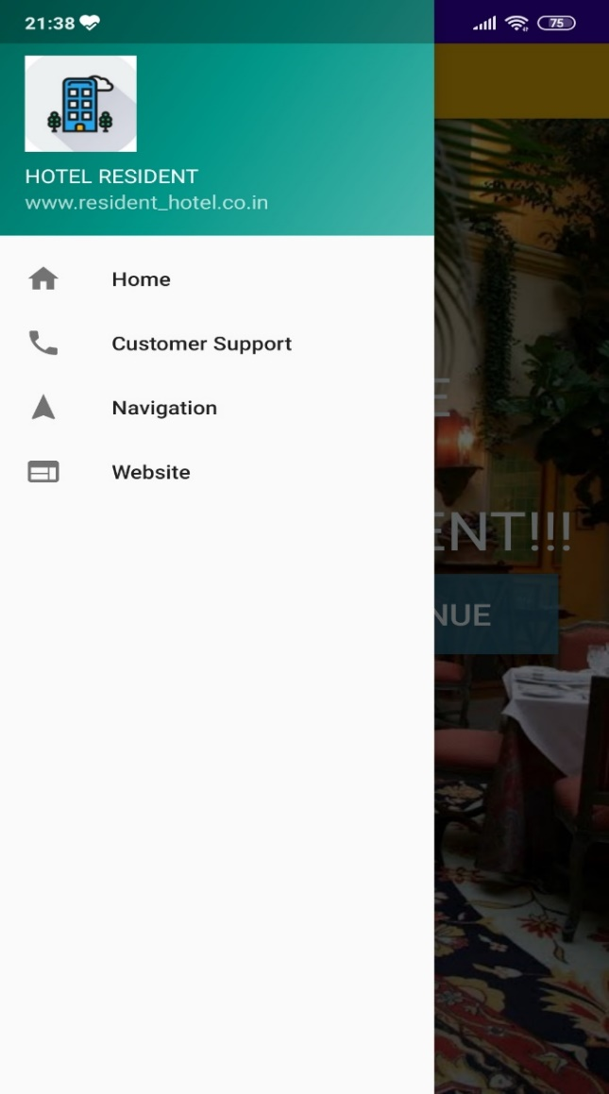
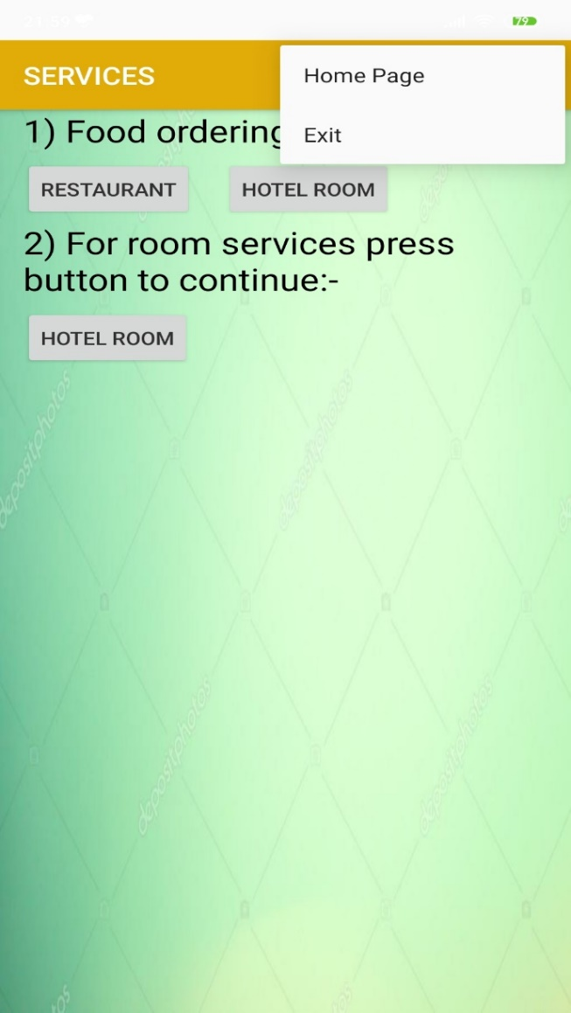
MOBILE APPLICATION FOR CUSTOMER SERVICES
HOME PAGE
NAVIGATION DRAWER
ACTION SETTINGS

Slide 15
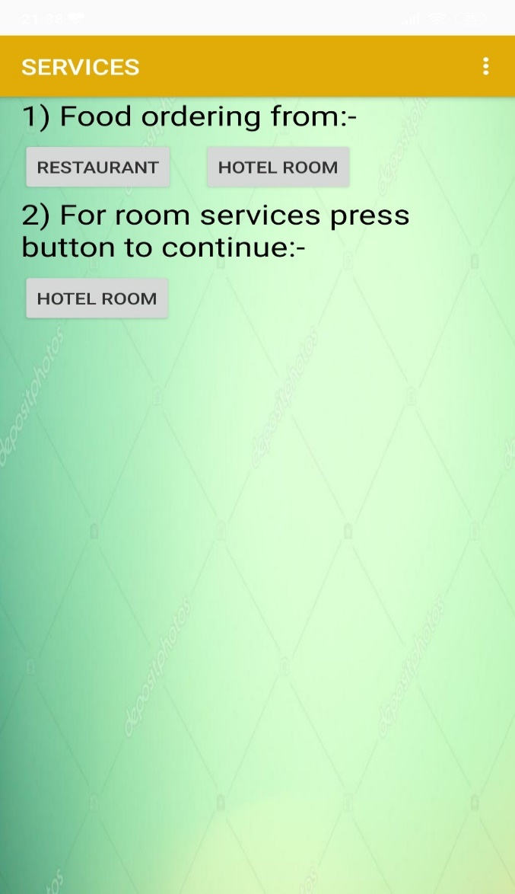
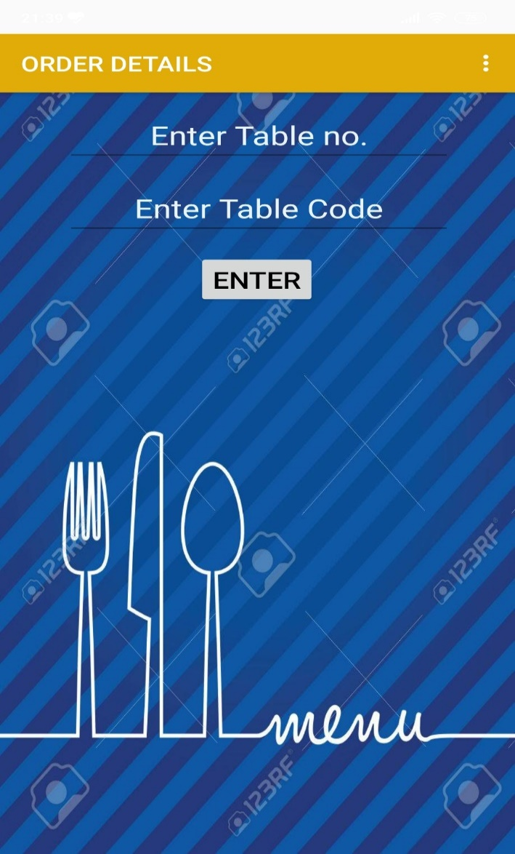
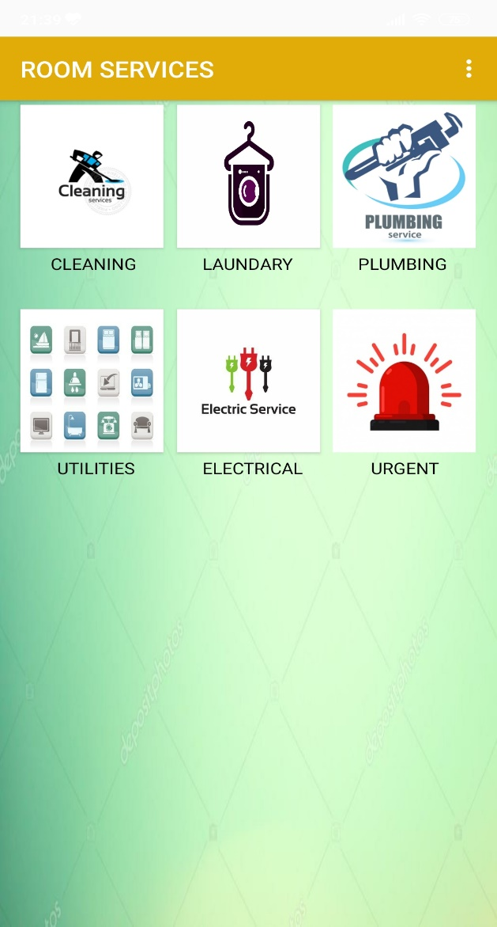
SERVICE LIST APPEARS AFTER CLICKING “ENTER” BUTTON
BY PRESSING EITHER OF THE FOOD ORDERING OPTIONS, THE ABOVE PAGE APPEARS
BY PRESSING THE “HOTEL ROOM” BUTTON IN SERVICE LIST, THE ABOVE PAGE APPEARS

Slide 16
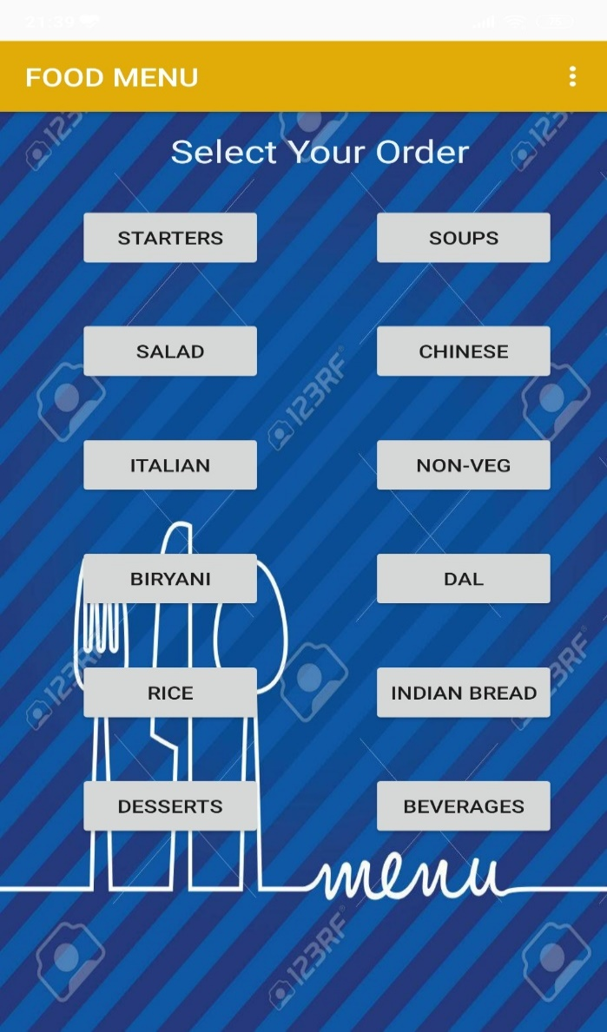
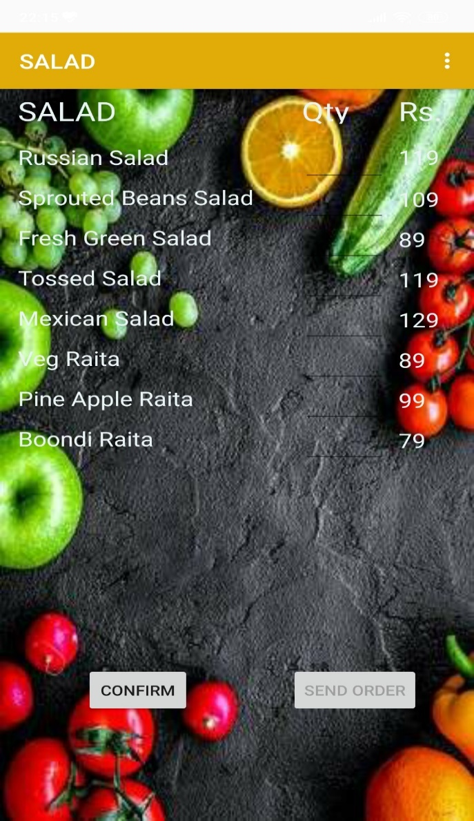
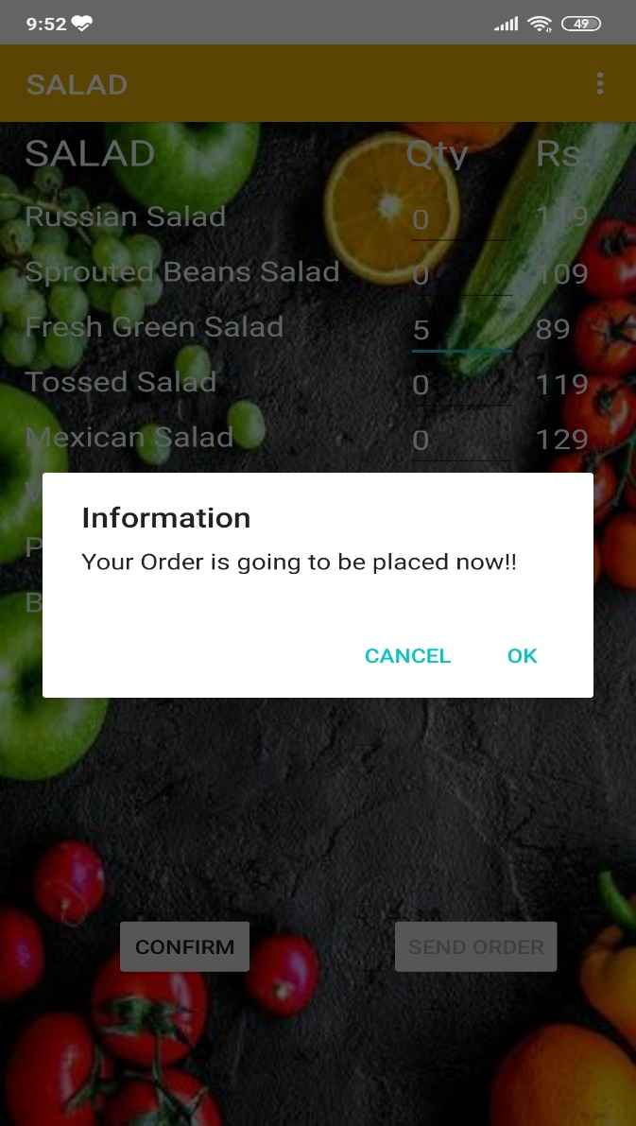
AFTER ENTERING THE CORRECT ORDER DETAILS, THE ABOVE “FOOD MENU” APPEARS
CHOOSING ANYONE OF THE FOOD OPTIONS, SIMILAR PAGE APPEARS AS SHOWN ABOVE
AFTERING THE REQUIRED ITEM DETAILS, SUCH A CONFIRMATION POP UP APPEARS

Slide 17

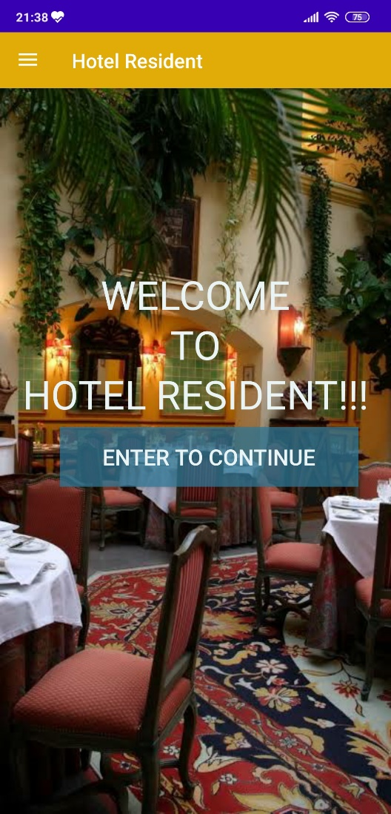
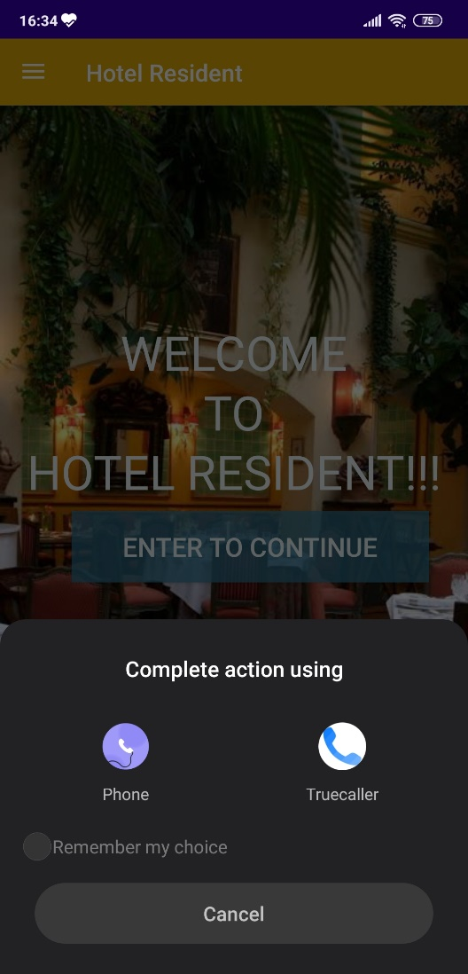
APP NAVIGATION DRAWER
NAVIGATION DRAWER
AFTER PRESSING “HOME” ITEM THIS HOME PAGE APPEARS
AFTER PRESSING “CUSTOMER SUPPORT” ITEM THIS OPTION APPEARS,TO MAKE CALL USING EITHER OF THE APP DEPENDING ON THE DEVICE

Slide 18
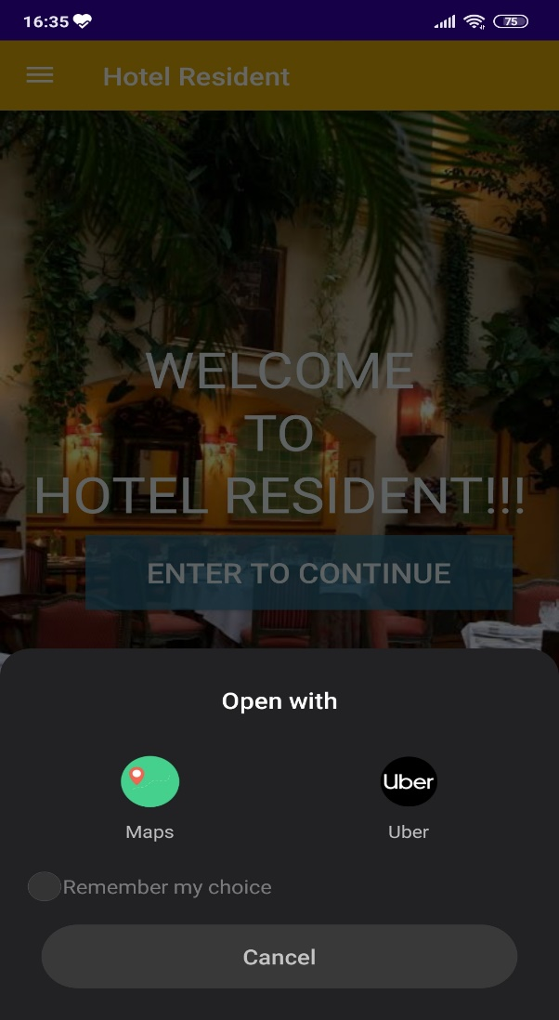
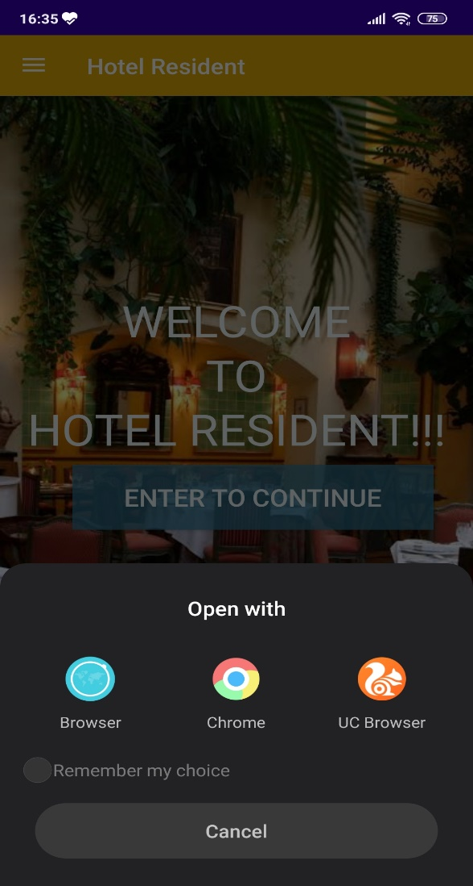
AFTER PRESSING “NAVIGATION” ITEM THIS OPTION APPEARS, TO NAGIVATE THE CUSTOMER TO THE HOTEL FROM WHICHEVER PLACE HE/SHE IS LOCATED
AFTER PRESSING “WEBSITE” ITEM THIS OPTION APPEARS, TO ACCESS THE HOTEL WEBSITE FOR ANY FURTHER ASSISTANCE

Slide 19
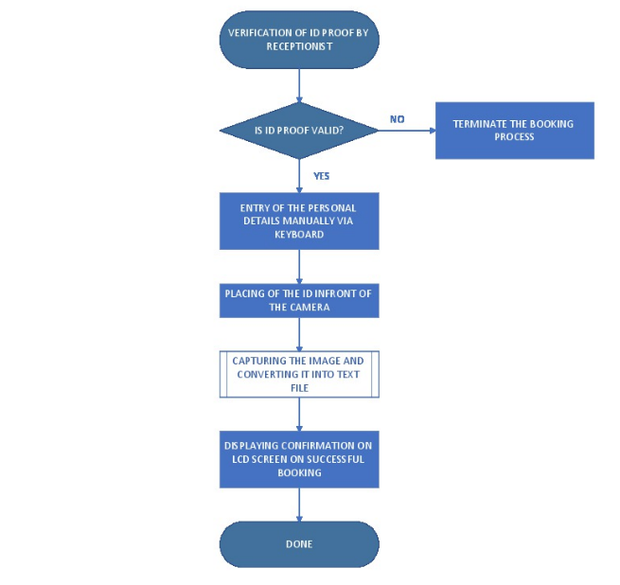
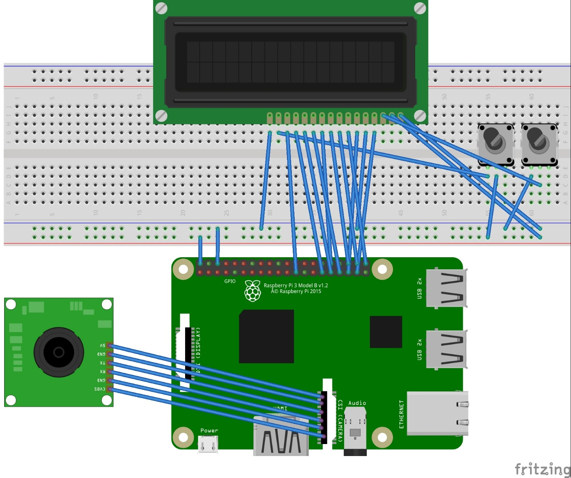
ROOM BOOKING

Slide 20
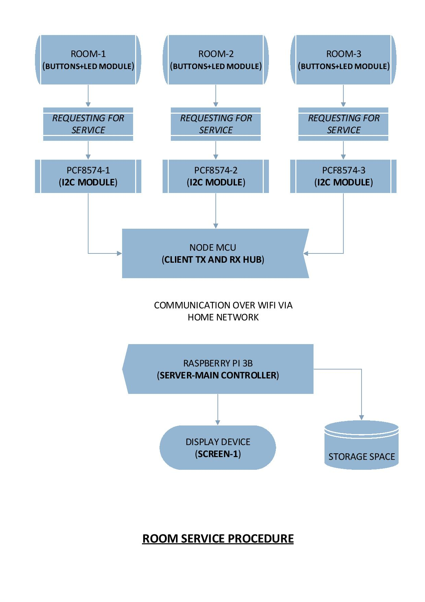

Slide 21
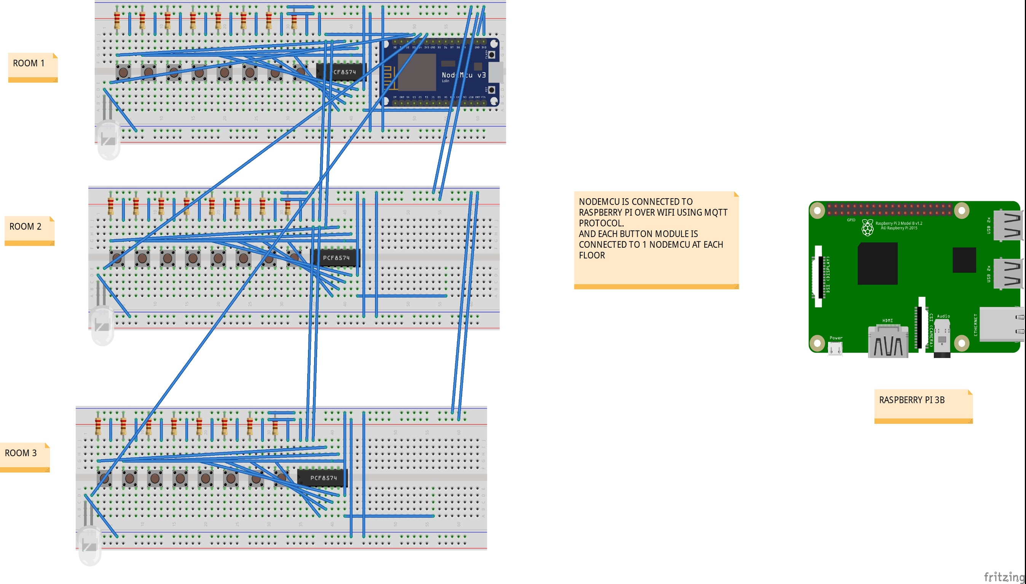

Slide 22
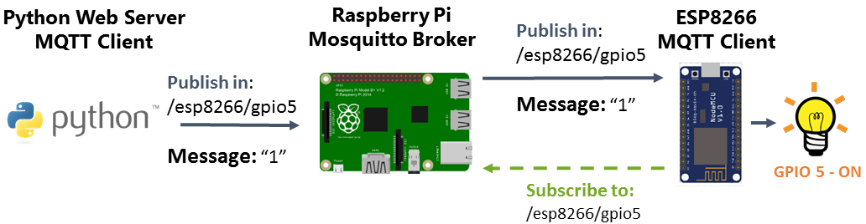
Hotel Automation is based on controlling appliances over WiFi via MQTT protocol.
Here, raspberry pi acts MQTT broker in which a python program runs continuously and monitors the connected devices in real time. While NodeMCU acts as MQTT client which is connected to relay module through wires.

Slide 23
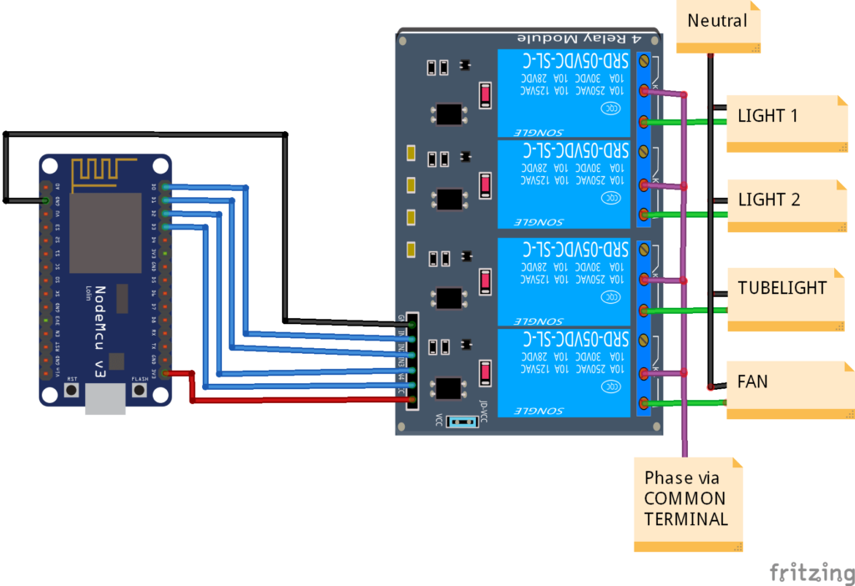
In this automation, the electrical appliances are made to ON/OFF according to time defined in the python program, which has been loaded in the raspberry pi.

Slide 24
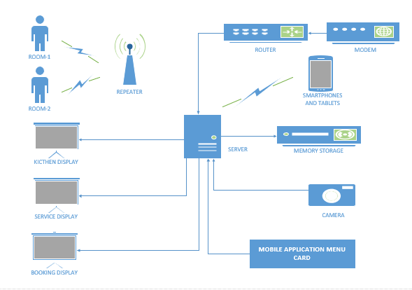
NETWORK DIAGRAM

Slide 25
ADVANTAGES AND DISADVANTAGES
Advantages:
Guest convenience
Time efficient
Cost reduction and increased revenue
Data Storage
Seamless Check-In and Bill Payments
Easy Installation
Privacy
Reduce man power

Slide 26
Disadvantages:
Internet Connection
Digital thief
Human-AI relation

Slide 27
APPLICATIONS
Hotel Automation
The mobile based application can be used in the hotels by avoiding the front desk i.e. booking a room, using room services.
Restaurant Automation
The same mobile based application can be used for a restaurant and selecting from the menu card order can be placed.

Slide 28
EXPECTED OUTCOMES
Easy to use and install
Reduces human efforts
Saves time
User friendly interface
Fast response for requests made
Reduction in Manpower.

Slide 29
THANK YOU

